Slide 1
Chemotaxis Chemical Concentration with CFD
Tim Davison
Advisors:
Dr. Nickels, Dr. Nguyen

Slide 2
Introduction
Previous chemotaxis simulations use a constant concentration gradient
This project: Uses computational fluid dynamics to model interactions of the robot with the environment (Colloidal Lattice Boltzmann)
Model a chemical source with wind by solving convection/diffusion equations
Method computes concentration at each point in the complex environment and feeds to existing controller

Slide 3
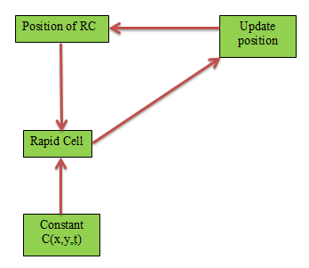

Slide 4
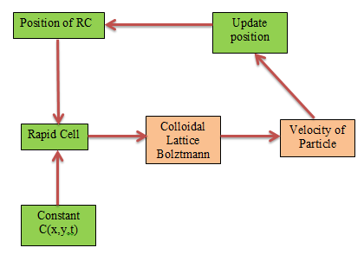

Slide 5
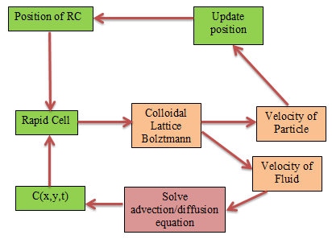

Slide 6
Objectives
Understand existing CLB MATLAB code coupled with Rapid Cell
Generate solution for 2D convection/diffusion equation to output concentration with MATLAB PDE Toolbox or other, pre-existing PDE Solver
Implement solution into existing Rapid Cell code using output from LBM
Testing and validation
Document and report results

